Slide 1
Flight Delay Prediction Using Cluster-Specific Ensemble Models
Classical ML, Cluster-Specific Ensemble, and LSTM
DASC-5380-W01 - DATA ANALYTICS
Sri Surya Pravallika Ajjarapu
Prathyusha Pentam
Texas A and M University – Corpus Christi
Notes:
“Good [morning/afternoon], I’m Prathyusha Pentam and this is Sri Surya Pravallika Ajjarapu.
Our project is Flight Delay Prediction Using Cluster-Specific Ensemble Models for the DASC-5380 Data Analytics course.
We’ll show how we use machine learning to predict flight delays using only pre-departure information.”

Slide 2
Flight delays cause frustration and extra costs for passengers, airlines, and airports.
They lead to missed connections, longer turnaround times, and inefficient use of gates and crews.
Predicting delays before departure can help with planning, rebooking, and resource allocation.
In this project, we use machine learning to predict whether a flight will be delayed by more than 15 minutes at arrival.
We focus on this 15-minute threshold because it is commonly used in on-time performance statistics.
We only use pre-departure information (airline, route, departure time, distance), so the model could be used in real time before the flight takes off.
In addition to classical models and a Cluster-Specific Ensemble, we also experiment with a simple LSTM neural network as a deep-learning baseline.
Introduction
Notes:
Flight delays are a common problem that cause frustration and extra costs for passengers, airlines, and airports.
They lead to missed connections, longer turnaround times, and inefficient use of gates and crews.
Our idea is to predict delays before departure so that airlines can plan better, rebook passengers earlier, and manage resources more efficiently.
In this project, we use machine learning to predict whether a flight will be delayed by more than 15 minutes at arrival, using only pre-departure information like airline, route, departure time and distance.
We compare standard global models with a Cluster-Specific Ensemble that first clusters similar flights and then trains a separate model in each cluster.

Slide 3
Problem Statement
– Goal
Our goal is to predict whether a flight will be delayed by more than 15 minutes at arrival.
– Type of Problem
We model this as a binary classification problem, where label 0 represents an on-time flight and label 1 represents a flight that is delayed by more than 15 minutes.
– Inputs (Pre-Departure Only)
We use only pre-departure information as input features, including the marketing airline, the origin and destination airports, the month and day of week, the scheduled departure time converted to minutes, and the flight distance.
– Data Challenge
The data are imbalanced, because most flights in the dataset arrive on time and only a smaller portion are delayed.
– Modeling Challenge
Delay behavior varies by route, airline, season, and time of day, which makes the prediction task more difficult for a single global model.
Notes:
“Formally, our goal is to predict whether a flight will be delayed more than 15 minutes at arrival.
This is a binary classification problem where 0 means on time and 1 means delayed more than 15 minutes.
We only use pre-departure features such as airline, origin, destination, month, day of week, departure time in minutes, and distance.
The data are imbalanced because most flights are on time, and delay patterns vary a lot by route, airline, season, and time of day, which makes the prediction challenging.”

Slide 4
Dataset Overview
Dataset Source
We use the Kaggle Flight Delay Prediction dataset, which contains several years of U.S. flight records from 2018 to 2022.
Observations
Each row in the dataset corresponds to a single flight and includes information about the airline, the route, the scheduled times, and the recorded delays.
Target Variable
Our target variable is ArrDel15, which is coded as 0 for on-time flights and 1 for flights delayed by more than 15 minutes at arrival.
Input Features (Pre-Departure Only)
We restrict ourselves to pre-departure features so that our model can realistically be used before the flight takes off. The features we use are month, day of week, scheduled departure time converted to minutes since midnight, flight distance, origin airport, destination airport, and the marketing airline code.
Sampling Strategy
The dataset is moderately large, so we optionally sample a subset of flights for faster training while keeping the overall delay rate and class balance similar too the full data.
Notes:
“We use the Kaggle Flight Delay Prediction dataset, which contains several years of U.S. flight records from 2018 to 2022.
Each row here represents a single flight and includes information about the airline, the route, the schedule and the recorded delay.
Our target variable is ArrDel15, which is 0 for on-time arrivals and 1 for arrivals delayed more than 15 minutes.
We restrict ourselves to pre-departure features so the model could realistically be used before the flight leaves the gate.
Because the dataset is fairly large, we optionally sample a subset of flights for faster training while keeping a similar delay rate.”

Slide 5
Implementation Flow
Load and clean Kaggle flight delay data.
Engineer pre-departure features (Month, DayOfWeek, CRSDepMinutes, Distance, Origin, Dest, Airline).
Apply shared preprocessing (impute, scale numeric, one-hot encode categorical).
Split into 80% train / 20% test (stratified).
Train global models (Dummy, LR, DT, RF, SVM) and a simple LSTM neural network on the same preprocessed features.
Build Cluster-Specific Ensemble (k-means on Month/DayOfWeek/time/distance + RF per cluster).
Evaluate RF, CSE, and LSTM on the test set and compare metrics.

Slide 6
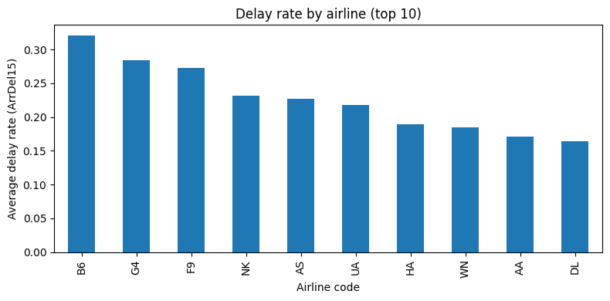
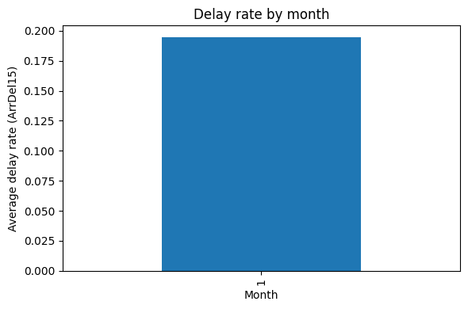
Exploratory Data Analysis
We first computed the overall delay rate and found that only a minority of flights are delayed more than 15 minutes.
We calculated the delay rate by airline and observed that some carriers have noticeably higher average delay rates than others.
We examined the delay rate by month, which suggests seasonal patterns where certain months show more frequent delays.
These patterns confirm that the data are imbalanced and heterogeneous, supporting our idea that different groups of flights may behave differently.
This EDA motivates our later use of clustering and cluster-specific models instead of relying on a single global model.
Overall delay rate (ArrDel15=1): 0.195
Notes:
First, we computed the overall delay rate and found that about 19.5% of flights in our sample are delayed more than 15 minutes, so delays are relatively rare.
On the plot on the left, we show delay rate by airline. We can see that some carriers have noticeably higher delay rates than others.
On the right, we look at delay rate by month, which suggests some seasonal variation, with certain months experiencing more delays.
These patterns confirm that the data are imbalanced and heterogeneous, which motivates trying cluster-specific models instead of only one global model.”

Slide 7
Preprocessing and Data Split
We built a single preprocessing pipeline that all models share so they use the same transformed data. For the numeric features (Month, DayOfWeek, CRSDepMinutes, Distance), we fill missing values with the median and then standardize them. For the categorical features (Origin, Destination, marketing airline code), we fill missing values with the most frequent category and apply one-hot encoding so the models can use them as numeric inputs.
After preprocessing, we split the dataset into 80% training and 20% testing, using a stratified split so that the proportion of delayed and on-time flights is similar in both sets. Because most flights in the data are on time, the classes are imbalanced, In several models (including Random Forest, SVM, and LSTM) we use class_weight = 'balanced' or appropriate strategies to handle the class imbalance." to give more weight to delayed flights during training and reduce the tendency of the models to always predict “on time.”
Train size: (120000, 7) Test size: (30000, 7)
Train delay rate: 0.19303333333333333
Test delay rate : 0.19303333333333333
Notes:
To make sure all models use the same transformed data, we built a single preprocessing pipeline.
For numeric features like Month, DayOfWeek, departure time in minutes and distance, we fill missing values with the median and standardize them.
For categorical features like origin, destination and marketing airline, we impute the most frequent category and apply one-hot encoding.
After preprocessing, we split the data into 80% training and 20% testing using a stratified split so the delay rate is similar in both sets, as shown at the bottom of the slide.
Because delays are less frequent, we also use class_weight = "balanced" in several models so that delayed flights receive more weight during training.

Slide 8

Global Baseline Models
Common Input Pipeline
We first apply the same preprocessing pipeline to all models (impute missing values, scale numeric features, one-hot encode categorical features) so every model sees exactly the same transformed features.
Majority-Class Dummy
We train a dummy classifier that always predicts the most frequent class (on-time). This gives a simple baseline to compare against more complex models.
Logistic Regression
We train a regularized logistic regression model on the preprocessed features to get a simple, interpretable linear baseline for the probability of delay.
Decision Tree
We train a decision tree classifier to capture basic nonlinear interactions between features such as airline, route, time of day, and distance.
Random Forest
We train a random forest with many trees as a stronger nonlinear global model. This becomes our best-performing global baseline in terms of F1 and ROC–AUC.
SVM (LinearSVC)
We train a linear SVM (with class_weight = "balanced") as another strong linear baseline that handles the class imbalance explicitly.
LSTM (Deep-Learning Baseline)
We use the same preprocessed features, convert them to dense arrays, reshape them as a 1-step sequence per flight, and train a small LSTM network. This gives a deep-learning baseline to compare against our tree-based models, but in practice it achieves similar ROC–AUC and much lower recall/F1 than the Random Forest and CSE.

Slide 9
Cluster-Specific Ensemble (CSE)
We observed that delay patterns vary by route, airline, season, and time of day, so a single global model may not capture all of this heterogeneity.
To group similar flights, we use numeric pre-departure features for clustering: Month, DayOfWeek, CRSDepMinutes (departure time in minutes), and Distance.
We standardize these features and apply k-means clustering with K = 4, assigning each flight to one of four clusters based on its time and distance profile.
For each cluster, we train a separate Random Forest classifier using only the flights belonging to that cluster.
At prediction time, we assign a test flight to a cluster with k-means and then use that cluster’s Random Forest to predict whether the flight will be delayed, forming our Cluster-Specific Ensemble (CSE).
Notes:
As we saw in the EDA, delay behavior varies by airline, route, time of day and season.
To capture this heterogeneity, we design a Cluster-Specific Ensemble.
We first take numeric pre-departure features – Month, DayOfWeek, departure time in minutes and distance – standardize them, and apply k-means clustering with K = 4.
Each flight is assigned to one of four clusters based on its time and distance profile.
For each cluster, we then train a separate Random Forest classifier using only the flights in that cluster.
At prediction time, a new flight is assigned to a cluster using k-means, and we use that cluster’s Random Forest to predict whether it will be delayed.

Slide 10
Evaluation Setup and Metrics
We evaluate all models on a held-out test set that was never used during training, using an 80%–20% stratified train–test split so the ratio of delayed vs on-time flights is similar in both sets.
Accuracy measures the overall fraction of flights that are correctly classified as on time or delayed.
Precision tells us what fraction of flights predicted as delayed are actually delayed, while recall tells us what fraction of truly delayed flights the model successfully detects.
The F1 score is the harmonic mean of precision and recall, summarizing their trade-off and being especially useful for our imbalanced dataset.
ROC–AUC measures how well the model separates delayed and on-time flights across all possible decision thresholds.
For key models (Random Forest and CSE), we also look at confusion matrices to see how many flights fall into the true positive, true negative, false positive, and false negative categories.
Notes:
We evaluate all models on a held-out 20% test set that was never used during training, using an 80/20 stratified split to keep the same delay ratio.
We report accuracy, which is the overall fraction of correctly classified flights.
We also use precision and recall: precision tells us, of the flights predicted as delayed, how many were truly delayed; recall tells us, of all delayed flights, how many we actually caught.
The F1 score combines precision and recall and is especially useful for our imbalanced data.
We also compute ROC–AUC, which measures how well the model separates delayed and on-time flights across thresholds, and we inspect confusion matrices for the Random Forest and the CSE.”

Slide 11
Results :- Global Models vs CSE
Global Best Model
Cluster-Specific Ensemble
Among all the global baseline models we tested, the Random Forest achieved the best overall performance on the test set.
It provided the strongest combination of accuracy, F1 score, and ROC–AUC, meaning it both classified flights well and separated delayed vs on-time flights effectively.
Compared to simpler models like Logistic Regression and Decision Tree, the Random Forest captured more of the nonlinear relationships between time, route, and delay. Even adding LSTM also Random Forest remains same
The Random Forest also handled the class imbalance reasonably well when we used class-weight balancing, improving detection of delayed flights.
Because of this performance, we treat the global Random Forest as our main baseline to compare against the Cluster-Specific Ensemble.
The Cluster-Specific Ensemble (CSE) clusters flights with k-means and trains a separate Random Forest in each cluster.
On the test set, the CSE achieves accuracy, F1 score, and ROC–AUC very close to the global Random Forest.
It does not significantly outperform the global Random Forest, suggesting that clustering only on time and distance is not enough to create much easier subproblems.
However, CSE shows that cluster-specific models can match a strong global model and could benefit from richer features like weather or congestion in future work.
We also include an LSTM model in the comparison; it achieves high overall accuracy due to the class imbalance but has very low recall and F1, meaning it rarely flags delayed flights
Notes:
Here we highlight the global Random Forest, which is our best single global model.
It captures non-linear relationships between features such as time, route and distance, and it handles class imbalance reasonably well via class weights.
Because of this strong performance, we use the Random Forest as our main baseline when judging the CSE.
This slide focuses on the Cluster-Specific Ensemble.
Remember that CSE clusters flights using k-means and trains a separate Random Forest in each cluster.
On the test set, its accuracy, F1 score and ROC–AUC are very close to the global Random Forest.
In other words, clustering on basic time and distance features alone does not give a big performance gain, but it shows that cluster-specific models can at least match a strong global model and provide a flexible framework for adding richer features in the future
Now we compare the performance of all models on the test set using these metrics. The detailed numbers are shown on the next slide.

Slide 12
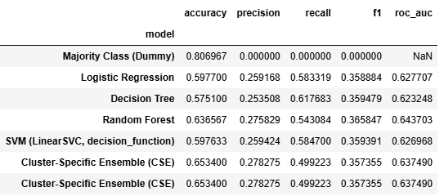
Test Set Metrics for All Models
Notes:
“This table shows the test-set metrics for all models.
The first row is the majority-class dummy model. It has high accuracy because most flights are on time, but its F1 score is zero and it has no ROC–AUC value, so it’s not useful for detecting delays.
Logistic Regression, Decision Tree and SVM all improve over the dummy model but still have moderate F1 and ROC–AUC.
The Random Forest stands out among the global models with the best combination of accuracy, F1 score and ROC–AUC around 0.64.
Our Cluster-Specific Ensemble (CSE) achieves very similar accuracy, F1 and ROC–AUC compared to the global Random Forest, so it can match the best global model but does not clearly outperform it.

Slide 13
LSTM Model
We trained a simple LSTM neural network on the same pre-departure features: Month, DayOfWeek, CRSDepMinutes (time), Distance, Origin, Destination, and marketing airline.
The input preprocessing is identical to our other models (median imputation for numeric features, scaling, most-frequent imputation + one-hot encoding for categorical features).
After preprocessing, we convert the feature matrix to a dense array and reshape each flight as a 1-step sequence so it can be fed into an LSTM layer.
The architecture is small: one LSTM layer with 32 units, a hidden Dense layer with 16 units (ReLU), and a final sigmoid output for binary classification.
On the held-out test set, the LSTM achieved approximately:
Accuracy ≈ 0.81
ROC–AUC ≈ 0.65
Recall ≈ 0.02 and F1 ≈ 0.03 for the delayed class
These numbers mean the LSTM has similar ROC–AUC and accuracy to Random Forest and CSE, but it almost never predicts “delayed”, leading to very low recall and F1

Slide 14
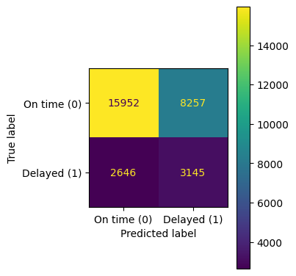
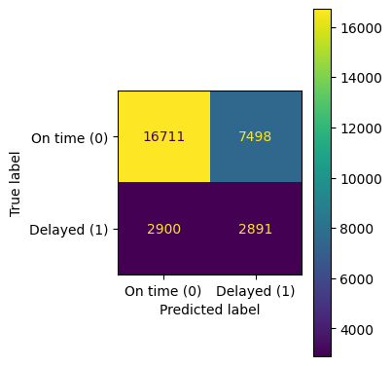
Confusion Matrices and Error Analysis
We plotted confusion matrices for both the global Random Forest and the Cluster-Specific Ensemble (CSE) on the test set.
In both models, the majority of on-time flights are correctly classified as on time (true negatives).
Both models also correctly identify a reasonable number of delayed flights (true positives), but some delayed flights are still missed and predicted as on time (false negatives).
The confusion matrices show a trade-off between catching more delays and avoiding false alarms, with CSE and the global Random Forest making very similar types of errors overall.
This error pattern supports our metric results: the CSE behaves similarly to the global Random Forest rather than clearly outperforming it.
The LSTM confusion matrix (not shown) is dominated by true negatives and very few true positives, consistent with its low recall: it rarely predicts ‘delayed
Notes:
These are the confusion matrices for the Random Forest on the left and the CSE on the right.
In both models, most on-time flights are correctly classified as on time – those are the large true-negative counts in the top-left cells.
Both models also correctly identify a reasonable number of delayed flights – the true positives in the bottom-right.
However, some delayed flights are still missed and predicted as on time, which are the false negatives in the bottom-left cells.
Overall, the patterns of errors are very similar for Random Forest and CSE, which is consistent with their similar F1 and ROC–AUC values.

Slide 15
Conclusion
We built a flight delay prediction system that uses only pre-departure information to predict whether a flight will be delayed by more than 15 minutes.
Among the global baseline models, the Random Forest achieved the best overall performance in terms of accuracy, F1 score, and ROC–AUC.
Our Cluster-Specific Ensemble (CSE), which clusters flights with k-means and trains a Random Forest in each cluster, achieved performance very similar to the global Random Forest.
This suggests that clustering on basic time and distance features alone does not provide a large improvement over a strong global model, but cluster-specific models can at least match global performance.
The additional LSTM experiment confirmed that a simple deep-learning model does not outperform our tree-based approaches on this tabular, imbalanced dataset.
Future Work
Add richer features such as weather, holidays, and airport congestion and test whether they improve both clustering and prediction.
Explore other clustering strategies and different model types within clusters (e.g., gradient boosting or XGBoost).
Perform more extensive hyperparameter tuning on the most promising models to see if performance can be further improved.
Explore more advanced deep-learning or sequence-based models (e.g., LSTMs or transformers on true time-series of historical delays per route) using richer temporal features
Notes:
To conclude, we built a flight delay prediction system that uses only pre-departure information to predict whether a flight will be delayed by more than 15 minutes.
Among our global models, the Random Forest achieved the best performance.
Our Cluster-Specific Ensemble, based on k-means clustering and Random Forests per cluster, achieved performance very similar to the global Random Forest.
This suggests that clustering on basic time and distance features alone does not greatly improve over a strong global model, but cluster-specific models can match that performance and are promising when richer features are available.
For future work, we would like to add richer features such as weather, holidays and airport congestion and see whether they improve both clustering and prediction.
We also plan to explore other clustering strategies and more powerful models inside clusters, such as gradient boosting or XGBoost, and perform more extensive hyperparameter tuning.

Slide 16
Thank you
Notes:
Thank you for your attention,

